Slide 1

Function of operating system
A presentation by Ashis Subedi

Slide 2

Agenda
4 | Introduction
5 | Process management
6 | Memory Management
7 | File system Management
8 | i/o management system
9 | Security access control
10 | User interface

Slide 3
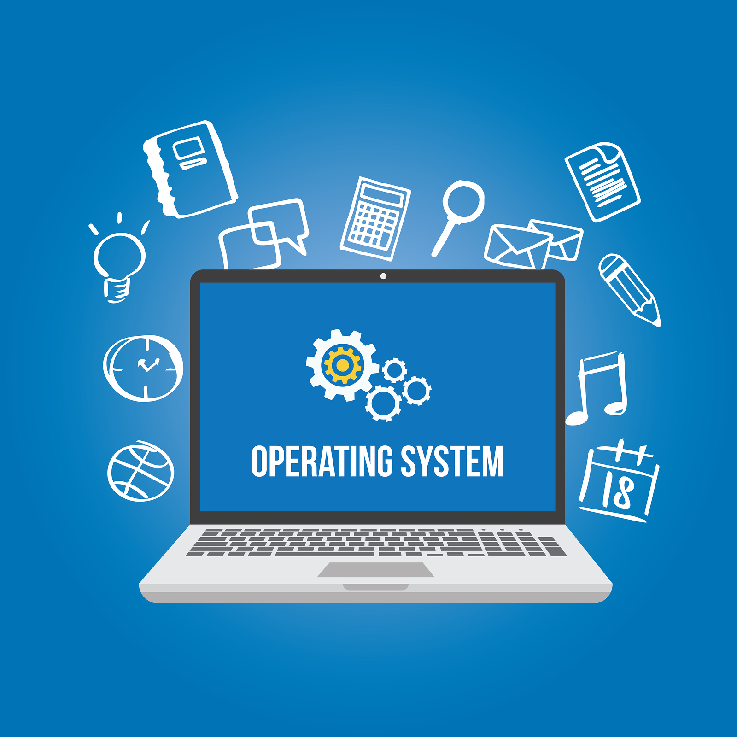


INTRODUCTION
An operating system (OS) manages computer hardware and software resources, ensuring smooth multitasking, optimized memory use, organized data storage, and efficient communication with external devices. These functions provide efficient, secure, and user-friendly computer operation.

Slide 4

Process Management Process Scheduling: Determines the order in which processes run to optimize CPU usage. Process Synchronization: Coordinates processes sharing resources to prevent conflicts. Inter-Process Communication (IPC): Enables processes to exchange data and coordinate actions.

Slide 5

Memory management
Allocation and Deallocation: The OS allocates memory to processes when they need it and deallocates it when they are done, ensuring efficient use of memory resources1.
Memory Protection: It ensures that processes do not interfere with each other’s memory space, maintaining data integrity and system stability2.
Swapping: The OS can move processes between main memory and disk storage to optimize memory usage and ensure that active processes have the necessary resources3.

Slide 6

File system Management
Organization: Structures data in directories and subdirectories.
Operations: Manages file creation, deletion, and access.
Space Management: Allocates and optimizes storage space.

Slide 7
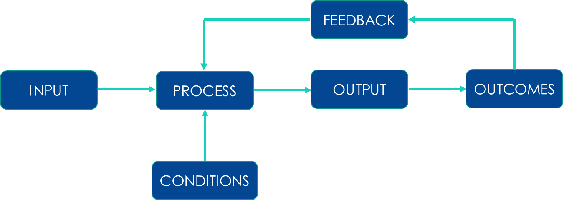

input output Management system Device Communication: Manages communication between the computer and external devices, ensuring data is correctly transferred. Interrupt Handling: Handles interrupts from I/O devices to manage data flow and prioritize tasks. Error Management: Detects and handles errors during data transfer to maintain system stability

Slide 8



Security and access control
Authentication: Verifies the identity of users through methods like passwords, biometrics, or security tokens.
Authorization: Determines and grants the appropriate level of access to resources based on user roles and policies.
Monitoring: Continuously tracks and audits access to detect and respond to unauthorized activities.

Slide 9

User interface
Interaction Point: The UI is where users interact with the computer, using elements like screens and keyboards.
Usability: It focuses on making interactions easy and efficient for users.
Design: Combines visual appeal with functionality for an intuitive experience.

Slide 10

THANK YOU
Ashis Subedi
ashisvlog12@gmail.com

